Slide 1
How to test DVB
1. Set up PSI Video Streams on PC
2. Install DVB Demos On akebi96 devices
3. Run DVB Demos

Slide 2
Set up PSI Video Streams on PC

Slide 3
Install DVB Demos On akebi96 devices
1. download source codes
git clone https://github.com/hihope/akebi96-dvbdemos.git
2. build
./init-android.sh
cd android/contrib
./compile-ffmpeg.sh clean
./compile-ffmpeg.sh all
cd ..
./compile-ijk.sh all
# Android Studio:
# Open an existing Android Studio project
# Select android/ijkplayer/ and import
# Select Run/Run ijkplayer-examples

Slide 4
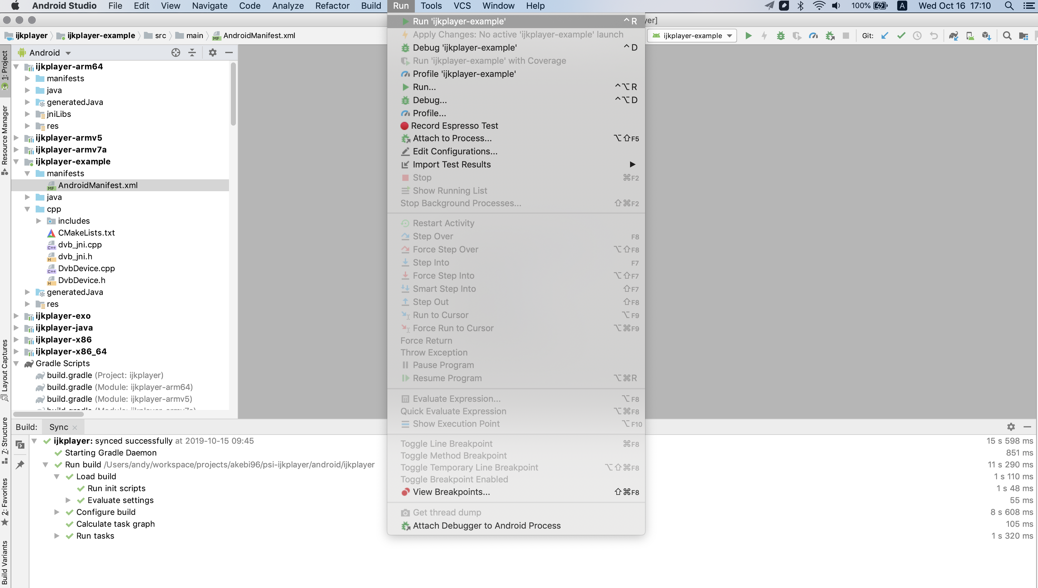

Slide 5
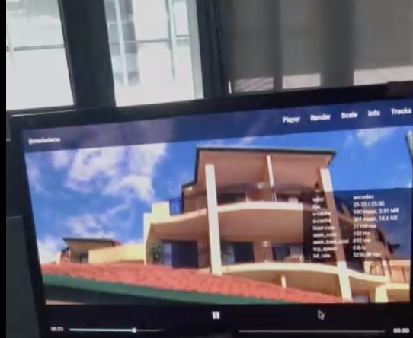
Run DVB Demos
Run demos by this steps :
# Select Settings
# Select Apps
# Select Brow system apps
# Select Show all apps
# Select ijkplaydemos
# Select Open

Slide 6
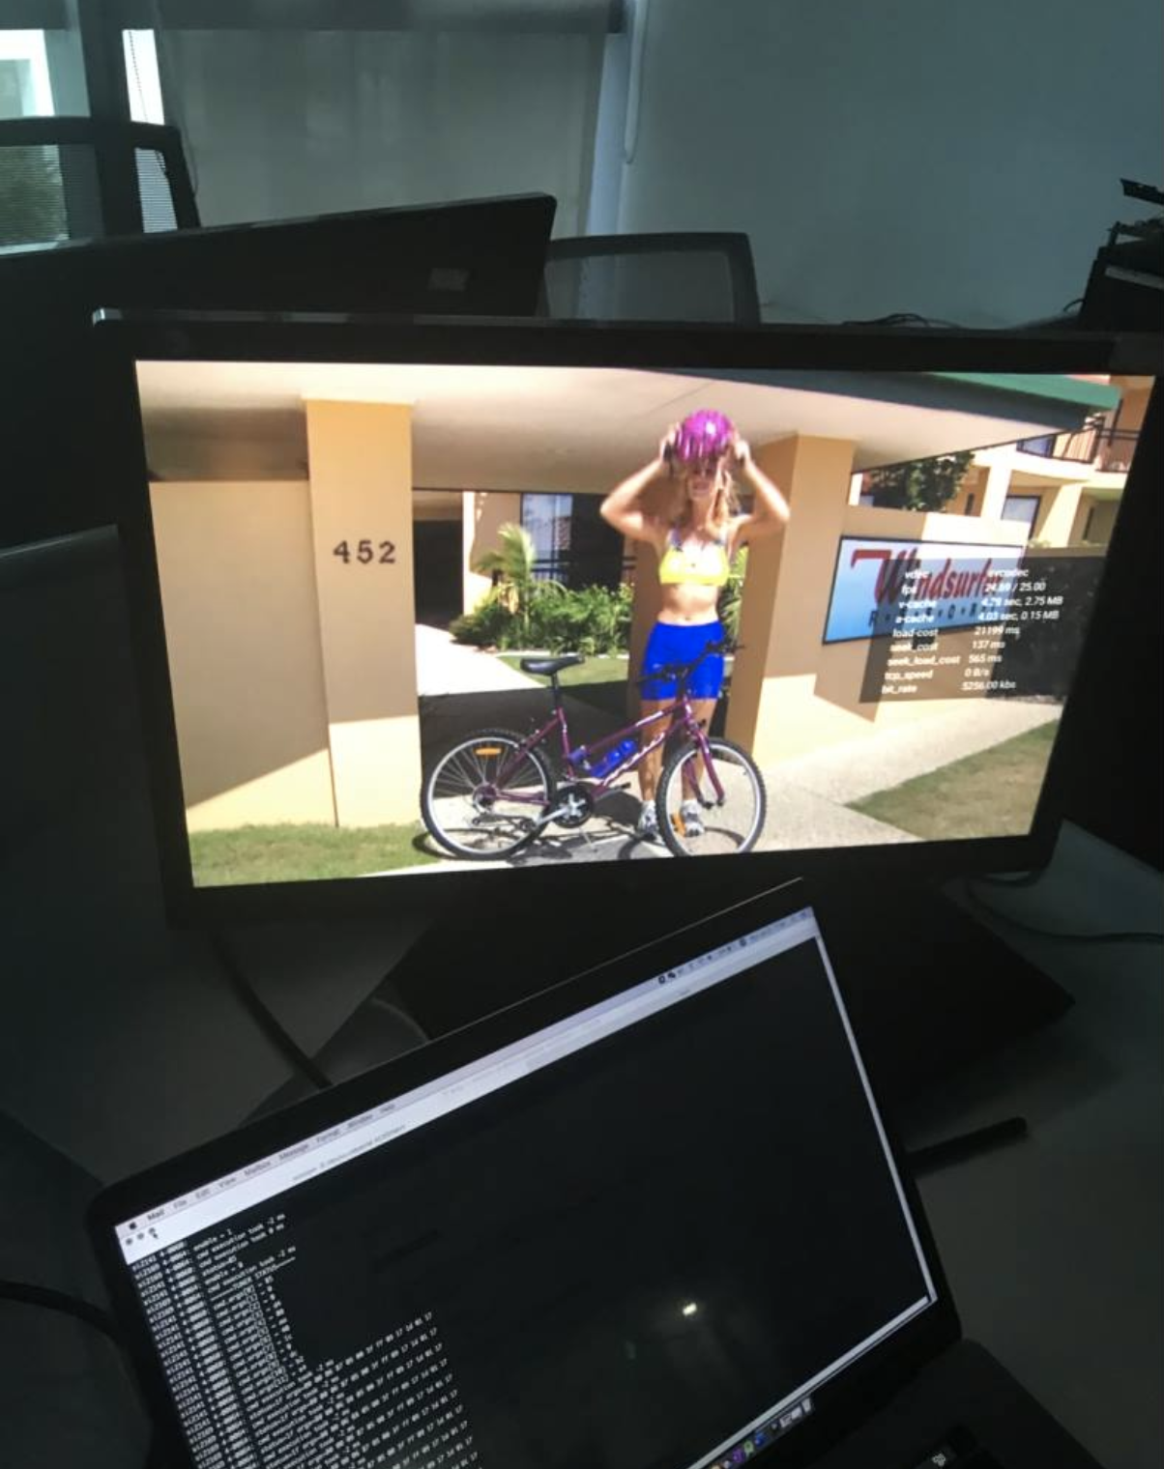
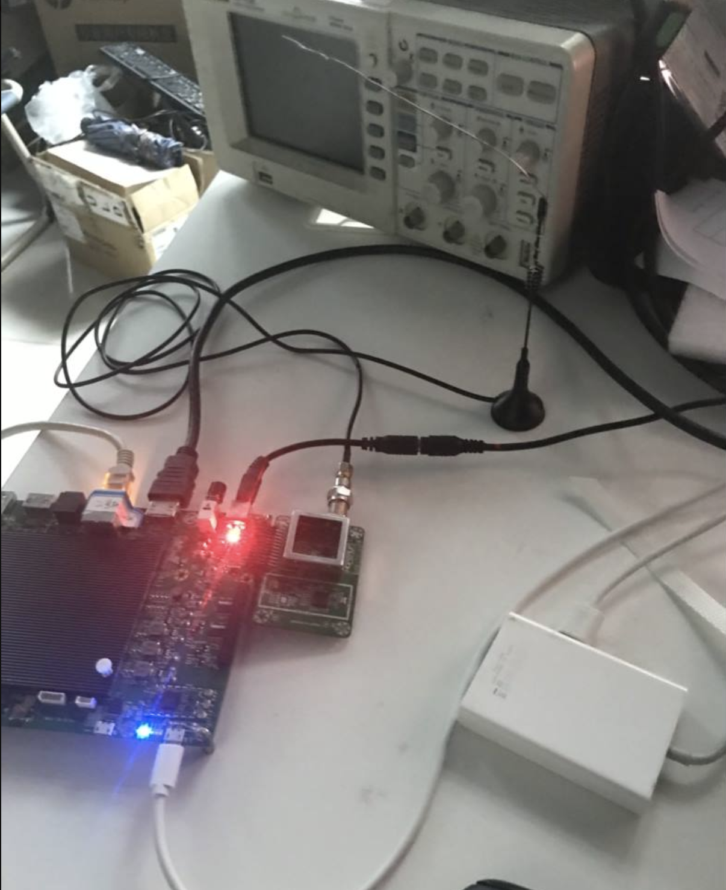
Akebi96 On Working

Slide 7
Videos
demo videos url:
https://pan.baidu.com/s/1Pt_vJDRFkcpHj71uNldvow
password: 24an

